Slide 1
MDC Mastering Spreadsheet Module 1
S2 bcom

Slide 2
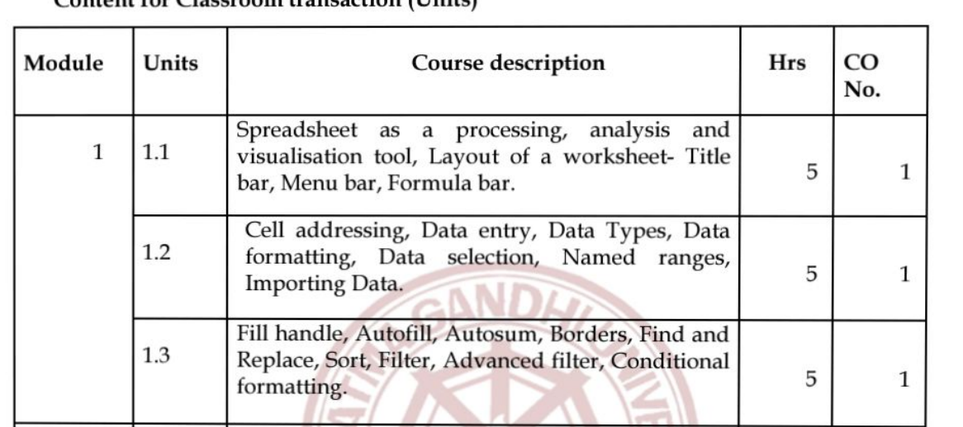

Slide 3
LIBREOFFICE
LibreOffice is a freely available, fully-featured, open source office productivity suite that is compatible with other major office suites and is available on a variety of platforms.
Its native file format is Open Document Format (ODF), and it can also open and save documents in many other formats, including those used by several versions of Microsoft Office.
For more information, see Appendix B, Open Source, Open Standards, OpenDocument.

Slide 4
LIBREOFFICE CALC
Calc (spreadsheet) Calc has all of the advanced analysis, charting, and decision making features expected from a high-end spreadsheet.
It includes over 500 functions for financial, statistical, and mathematical operations, among others.
The Scenario Manager provides “what if” analysis.
Calc generates 2D and 3D charts, which can be integrated into other LibreOffice documents.
You can also open and work with Microsoft Excel workbooks and save them in Excel format.
Calc can also export spreadsheets in several formats, including for example Comma Separated Value (CSV), Adobe PDF and HTML formats.

Slide 5
Other features provided by Calc include:
• Functions, which can be used to create formulas to perform complex calculations on data.
• Database functions, to arrange, store, and filter data.
• Dynamic charts, including a wide range of 2D and 3D charts.
• Macros, for recording and executing repetitive tasks; scripting languages supported include LibreOffice Basic, Python, BeanShell, and JavaScript.
• Ability to open, edit, and save Microsoft Excel spreadsheets.
• Import and export of spreadsheets in multiple formats, including HTML, CSV (without or with formulas), dBase, PDF, and PostScript.
• Collaborate with others seamlessly by sharing the spreadsheet.

Slide 6
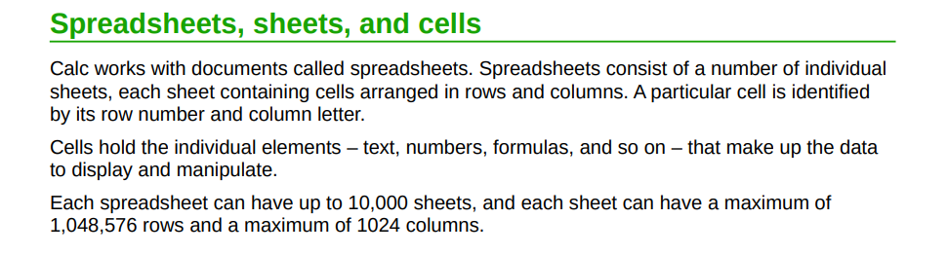

Slide 7
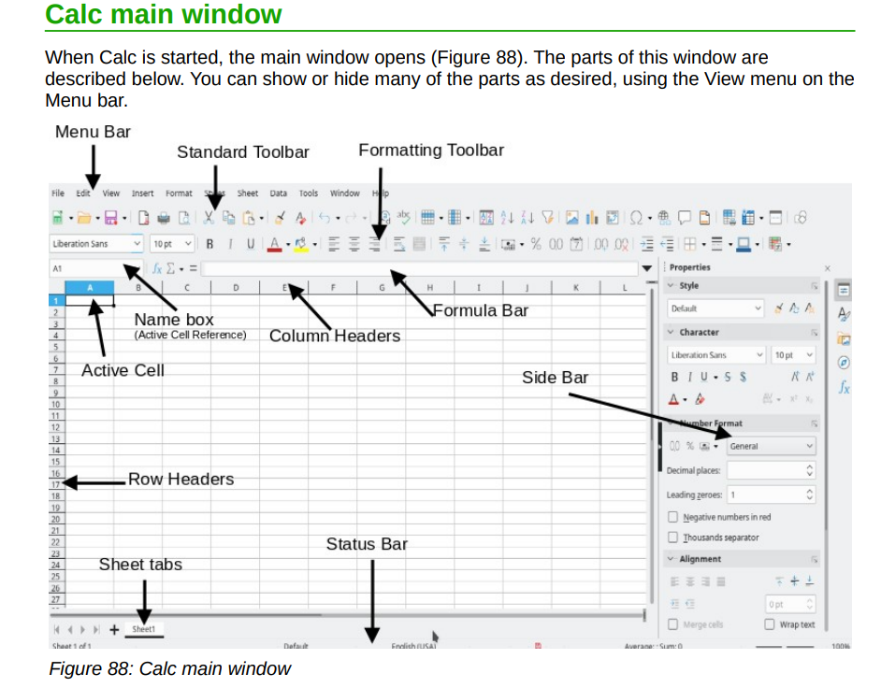

Slide 8
TITLE BAR
The Title bar is located at the top of the LibreOffice window. It shows the file name of the current document.
When the document is not yet named, the document name will appear as Untitled X, where X is a number.
Untitled documents are numbered in the order in which they are created.

Slide 9
MENU BAR
The Menu bar is located just below the Title bar in Windows and Linux and at the top of the screen in macOS.
When you select one of the menus, a submenu drops down to show further options, including:
• Commands that directly cause an action, such as Close or Save in the File menu.
• Commands that open dialogs. These are indicated by three dots following a command, such as Find and Replace... in the Edit menu.
• Commands that open further submenus.
These are indicated by a right-pointing arrow following a command, such as Toolbars and Zoom, in the View menu.
Moving the cursor onto one of these items causes its submenu to open.

Slide 10
TOOLBARS
This submenu lists the toolbars that are available in spreadsheets. This overview describes the default toolbar configuration for LibreOffice.
Standard Bar
The Standard bar is available in every LibreOffice application.
Formatting Bar
The Formatting bar contains basic commands for applying manually formatting.
Tools Bar
Use the Tools bar to access commonly used commands.
Formula Bar
Use this bar to enter formulas.
Drawing Bar
The Drawing bar contains frequently used editing tools. Click the arrow next to an icon to open a toolbar that contains additional commands.
Find Bar
The Find toolbar can be used to quickly search the contents of LibreOffice documents.

Slide 11
Image Bar
The Image bar is displayed when you insert or select an image in a sheet.
Drawing Object Properties Bar
The Drawing Object Properties Bar for objects that you select in the sheet contains formatting and alignment commands.
Text Formatting Bar
The Text Formatting Bar that is displayed when the cursor is in a text object, such as a text box or a drawing object, contains formatting and alignment commands.
Print Preview Bar
The Print Preview bar is displayed when you choose File - Print Preview.
Status Bar
The Status Bar displays information about the current sheet.
Insert
Click the arrow next to the icon to open the Insert toolbar, where you can add graphics and special characters to the current sheet.
Classification Toolbar

Slide 12

FORMULA BAR
The Formula Bar is located at the top of the sheet in the Calc workspace.
It is permanently docked in this position and cannot be used as a floating toolbar.
However, it can be hidden or made visible by selecting or deselecting
View > Formula Bar on the Menu bar

Slide 13
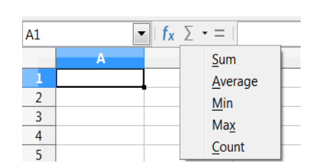
Name Box –
gives the current active cell reference using a combination of a letter and number, for example A1.
Function Wizard –
opens a dialog from which you can search through lists of available functions and formulas. This can be very useful because it also shows how the functions are formatted.
Select Function –
this drop-down list provides five choices: Sum, Average, Min,
Max, and Count
Input line –
displays the contents of the selected cell (data, formula, or function) and allows you to edit the cell contents.
To turn it into a multi-line input area for very long formulas, click the down arrow on the
far right-hand end of the Input line.

Slide 14
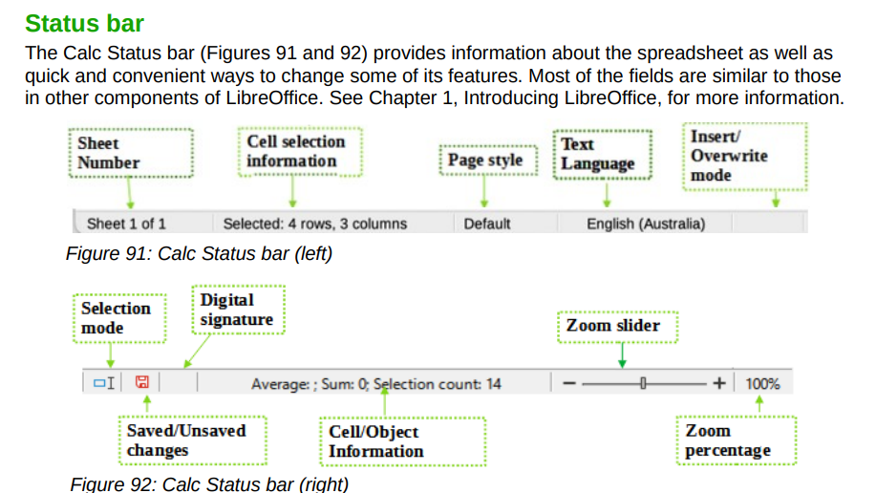

Slide 15
CELL ADDRESS/CELL REFERENCE
A cell reference identifies the location of a cell or group of cells in the spreadsheet also referred as a cell address.
It is used in formulas ,functions ,charts etc..
Eg:A1
Types of references
Absolute reference : Eg:$A$1
Relative reference :eg:A1
Mixed reference :eg:A$1,$A1

Slide 16
DATA ENTRY
Entering data into a spreadsheet can be very labor-intensive, but Calc provides tools for removing some of the drudgery from input.
These tools include drag and drop (to move or copy contents of one location to another using a mouse), an AutoInput tool, the Fill tool, and selection lists.

Slide 17
AUTOINPUT TOOL
The AutoInput function in Calc automatically completes entries, based on other entries in the same column. The column is scanned up to a maximum of 2000 cells or 200 different strings.
FILL TOOL
It can use the Fill tool in Calc to duplicate existing content or create a series in a range of cells in the spreadsheet

Slide 18
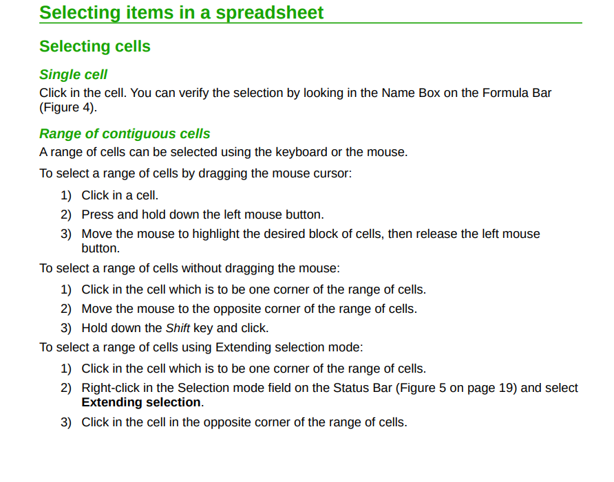

Slide 19
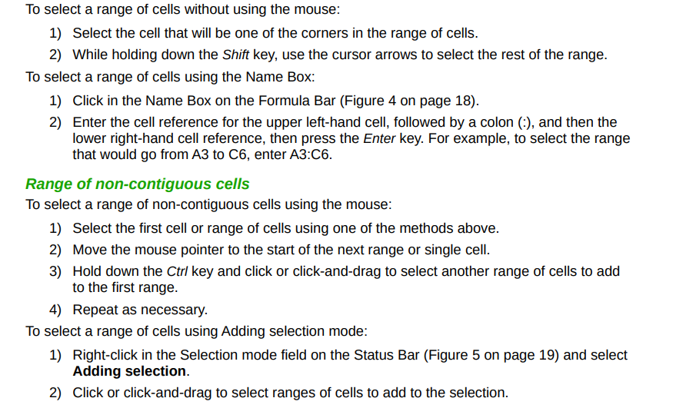

Slide 20
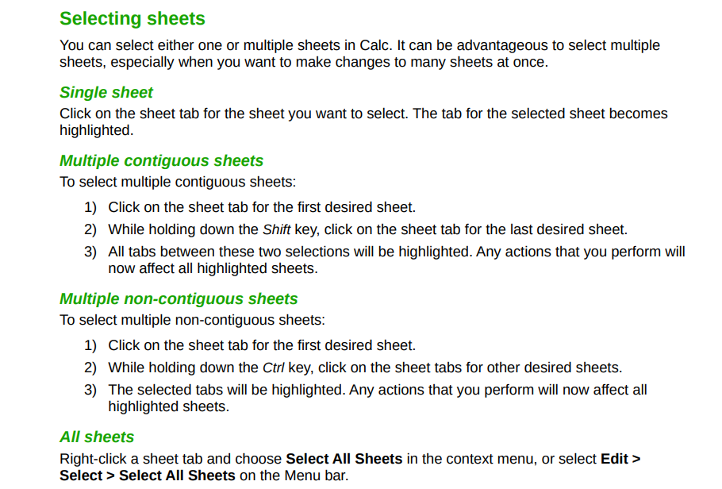

Slide 21
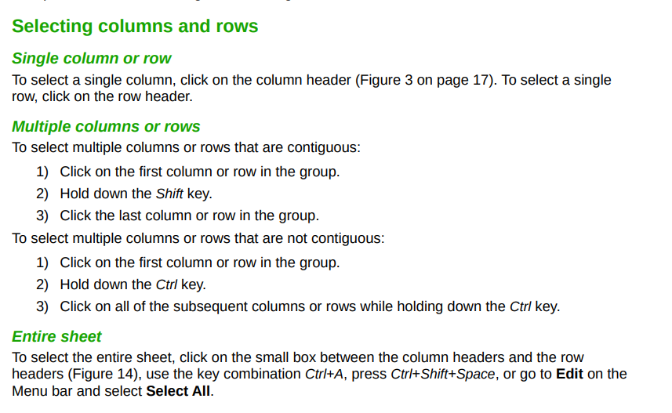

Slide 22
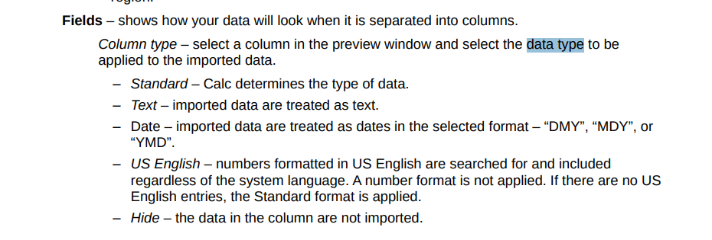
DATA TYPES:
Includes text, numbers, dates, and formulas.

Slide 23
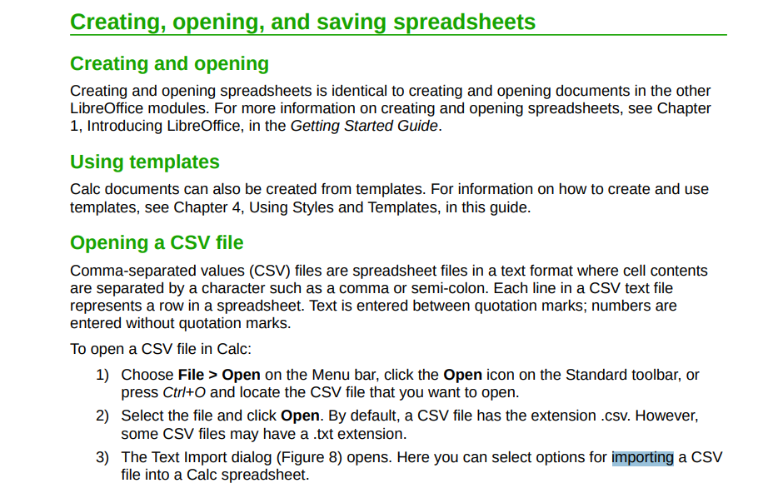

Slide 24
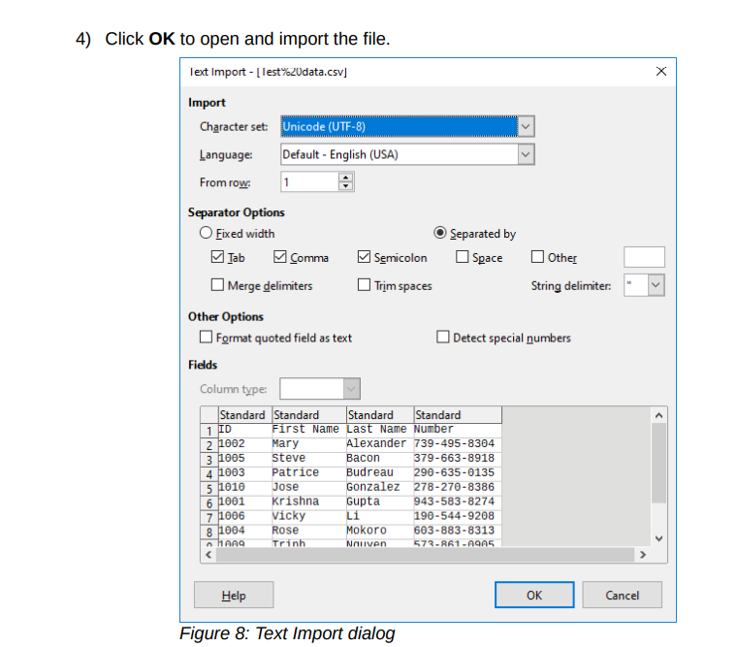

Slide 25
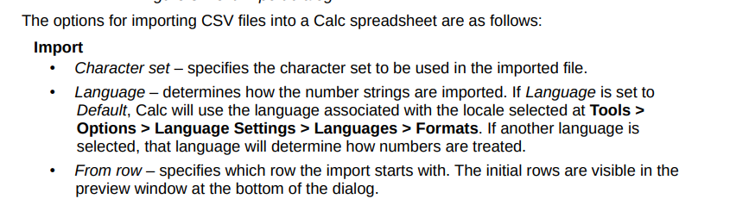

Slide 26
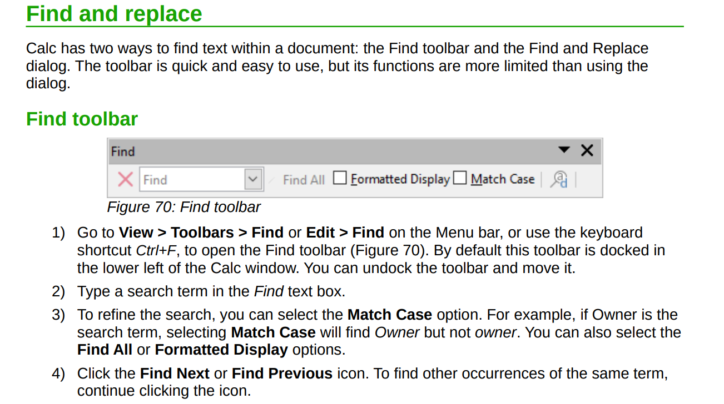

Slide 27
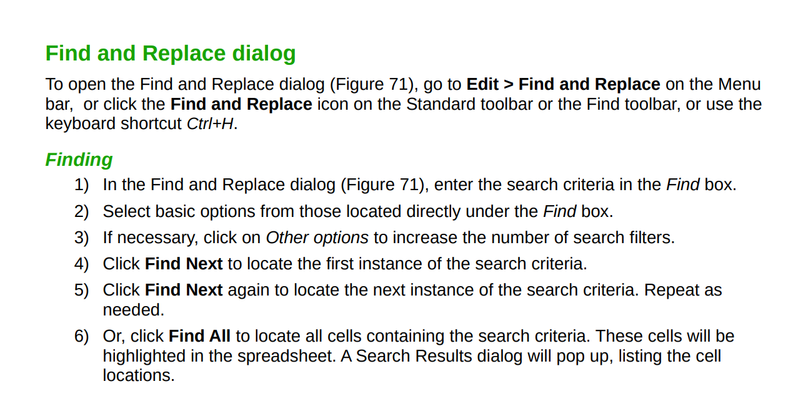

Slide 28
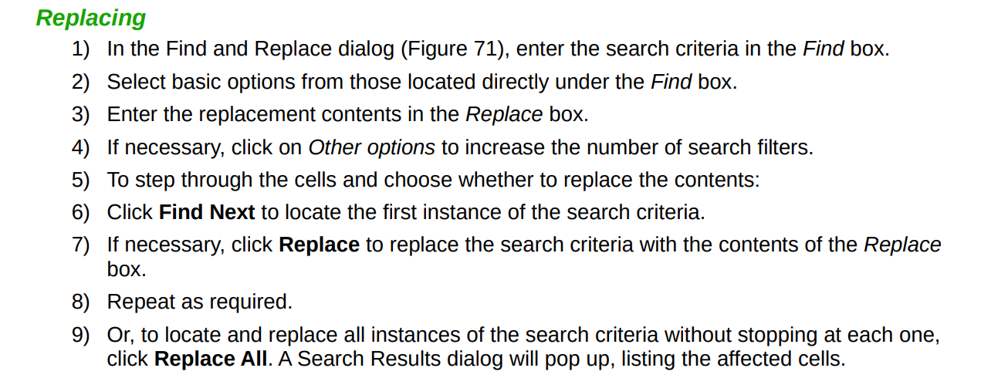

Slide 29
SORT
Sorting within Calc arranges the cells in a sheet using the sort criteria that you specify.
Several criteria can be used and a sort applies each criteria consecutively.
Sorts are useful when you are searching for a particular item and become even more useful after you have filtered data.

Slide 30
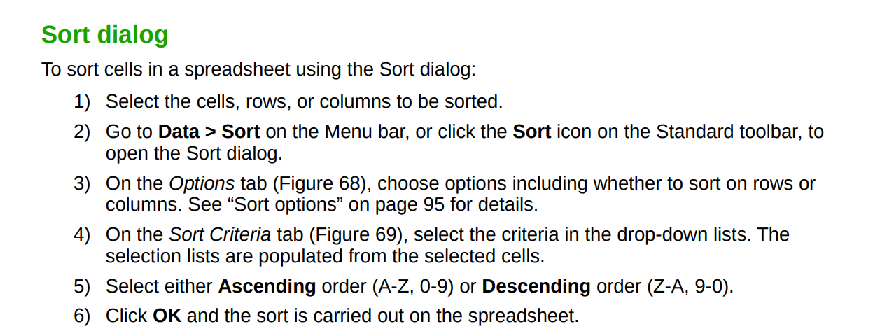

Slide 31
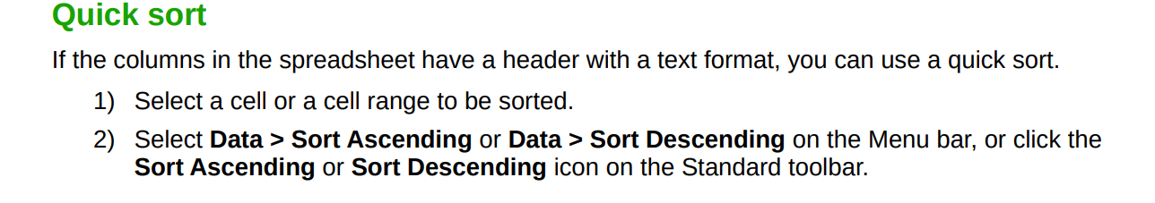

Slide 32
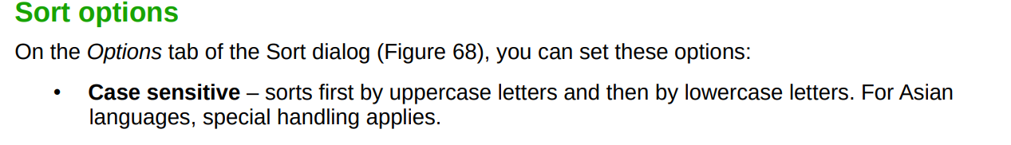
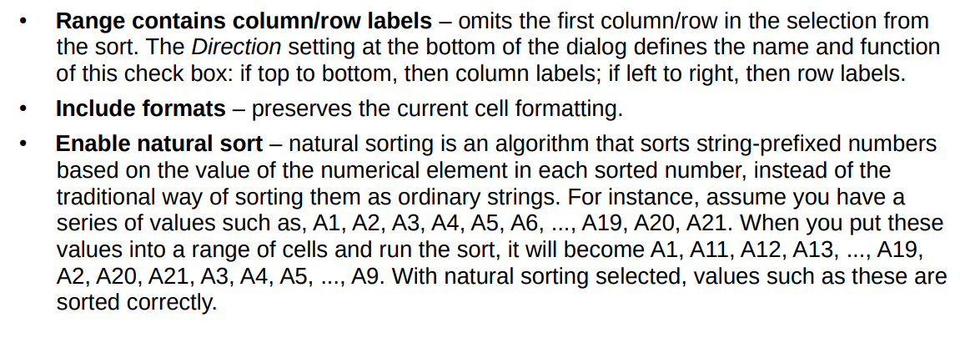

Slide 33
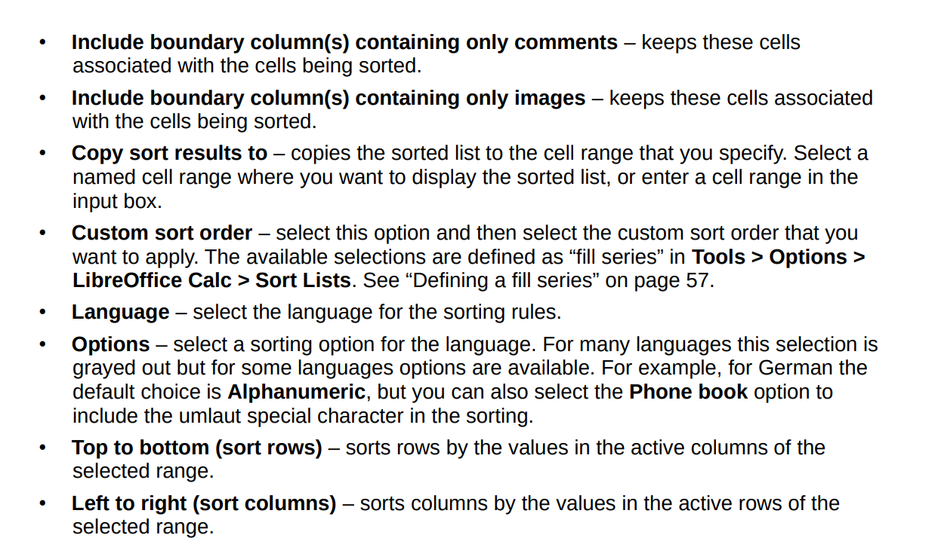

Slide 34
NAMED RANGES
Cells and cell ranges can have a name assigned to them.
Naming cells and ranges enhances formula readability and document maintenance.
A simple naming a range of cells B1:B10 as “Weight” and
sum all weights.
The formula is =SUM(B1:B10).
When the range B1:B10 is named as Weight,
you can transform the formula to =SUM(Weight)
The advantage is clear in terms of readability of the formulas.

Slide 35
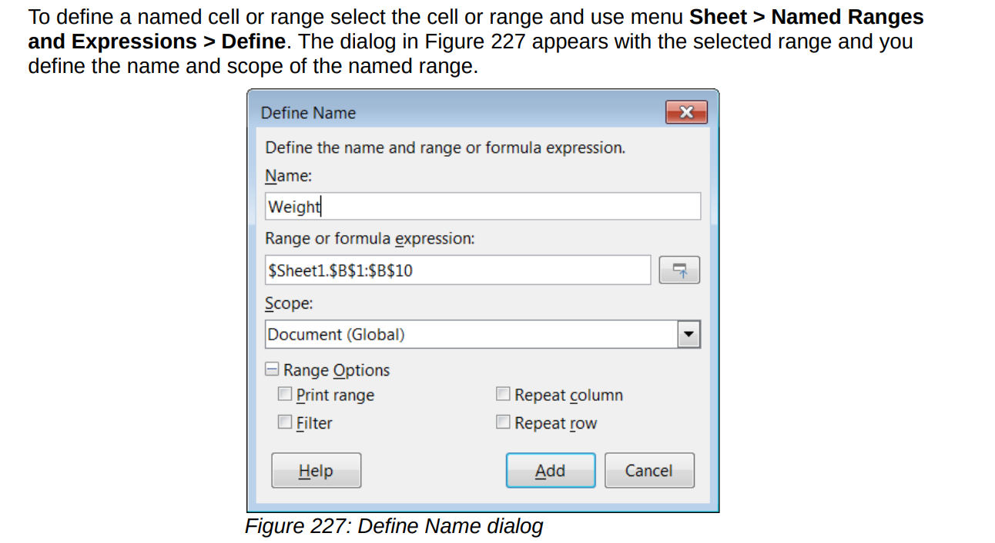
To modify a named range, use the Manage Names dialog .This dialog is accessed
by selecting Sheet > Named Ranges and Expressions > Manage on the Menu bar or pressing Ctrl+F3.

Slide 36
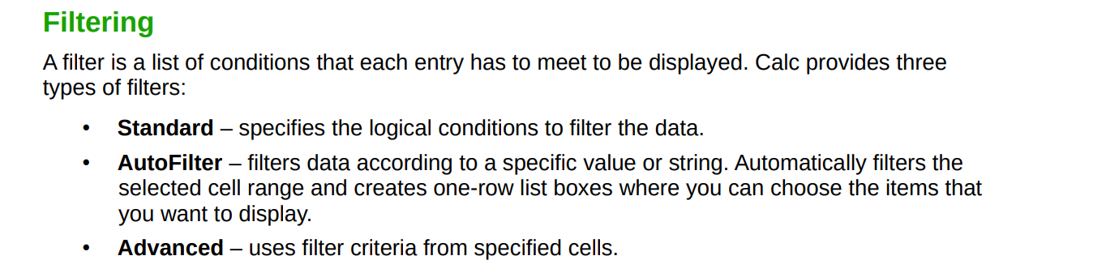

Slide 37
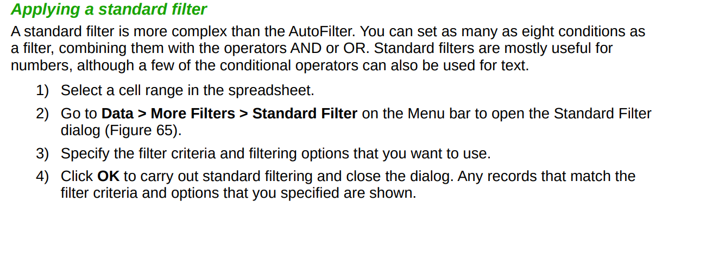
Standard filters are more complex than AutoFilters, and allow for up to eight filter conditions.
Powerful filters can be set up using regular expressions.

Slide 38
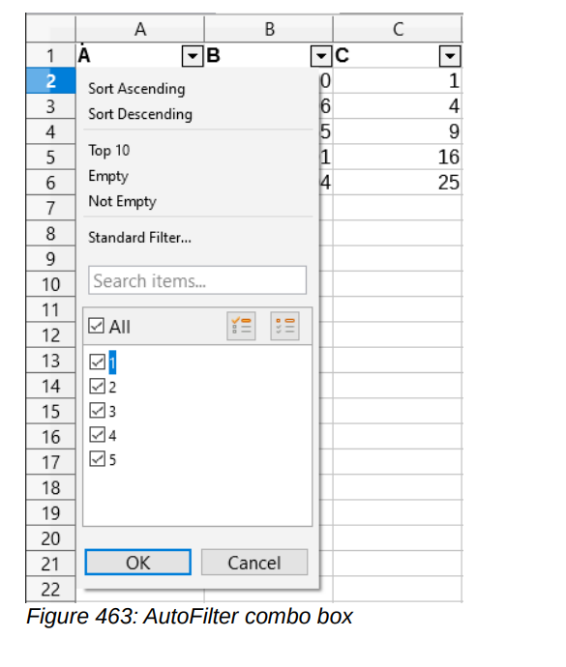
AUTOFILTER
AutoFilters are the most straightforward of the three filter types.

Slide 39
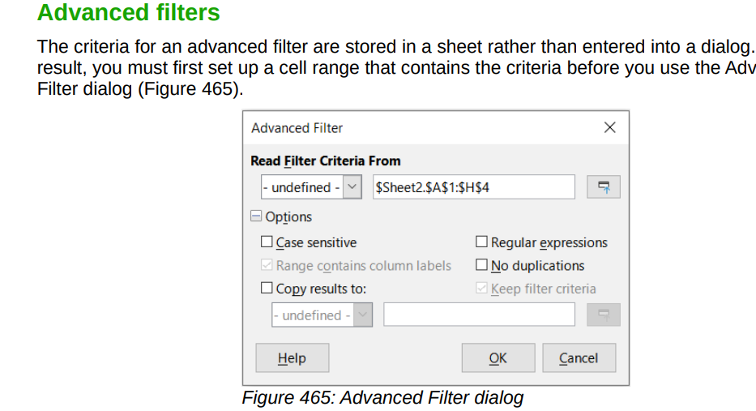

Slide 40
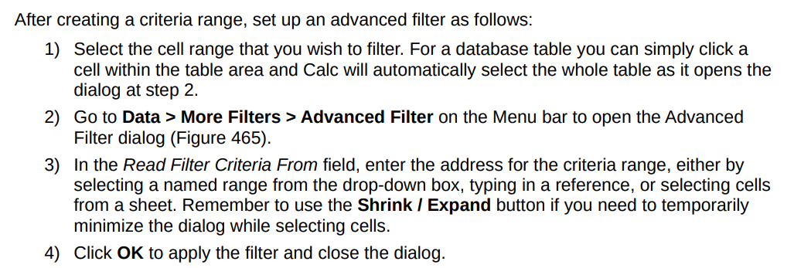

Slide 41
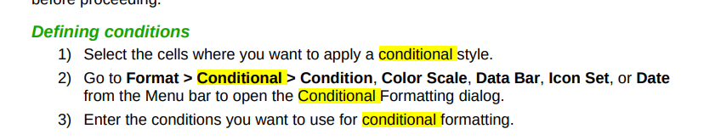
CONDITIONAL FORMATTING
You can set up cell formats to change depending on conditions that you specify.
Conditional formatting is used to highlight data that is outside the specifications that you have set.
It is recommended not to overuse conditional formatting as this could reduce the impact of data that falls outside those specifications.

